Slide 1
Keeping Your Research Safe with Backups
Love Data Week 2020

Slide 2


Slide 3
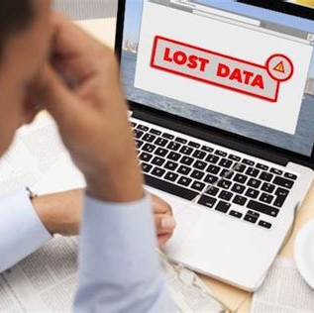

Why Should You Backup?
Data Loss Horror Stories
Data Loss Success Stories
Notes:
Why Should You Backup? “Unfortunately, I know many people who didn’t back their work up until they had something really bad (or almost bad) happen to them. Anything from data being corrupted, to a computer being damaged.”
Data Loss Horror Stories – Sh. did all his work on a laptop, someone stole his backpack out of his car, all data gone. Undergrads doing part of a project over the summer, they leave without telling me where the data is. “Does anyone have a horror story of their own they’d like to share?”
Data Loss Success Stories – “What about a success story?” Trying to make room on my free Dropbox accnt, deleted some files and the “trash” folder, panicked when I realized it was my dissertation !! But then I remembered my back-up hard drive on my machine in my office

Slide 4

Who Should Backup?
Notes:
Should a graduate student back up their dissertation or thesis?
Should a professor back up the book they’re writing?
Who else?
What about the stay-at-home dad of two kids? Well, does he have information/data/work?
Anyone who has anything that they don’t want to lose. One thing to think about in your personal lives – photos!

Slide 5
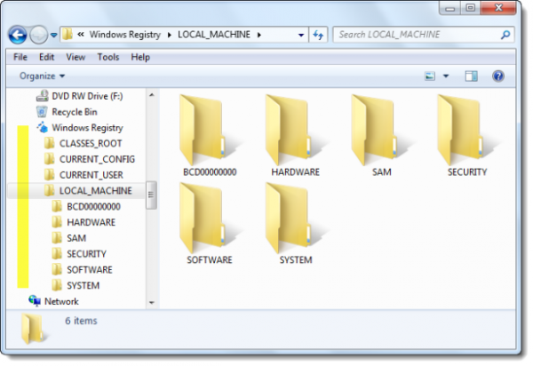
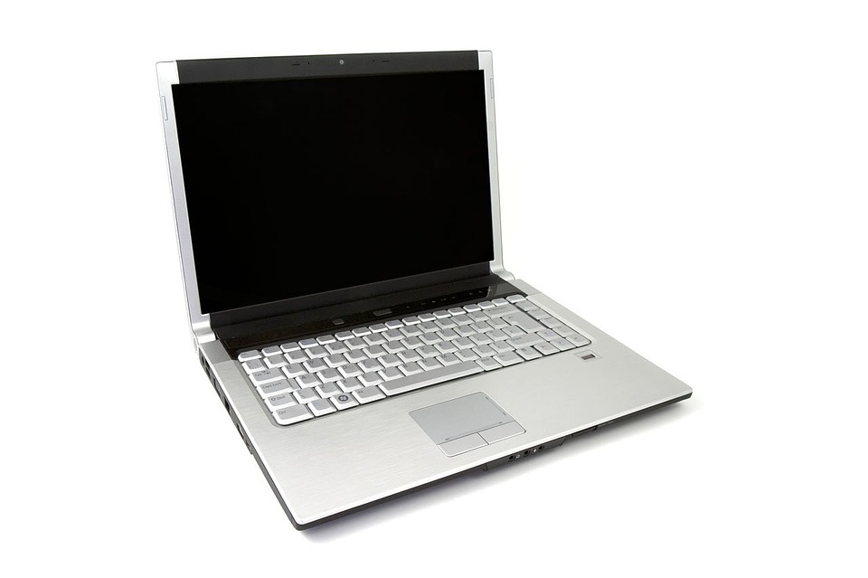
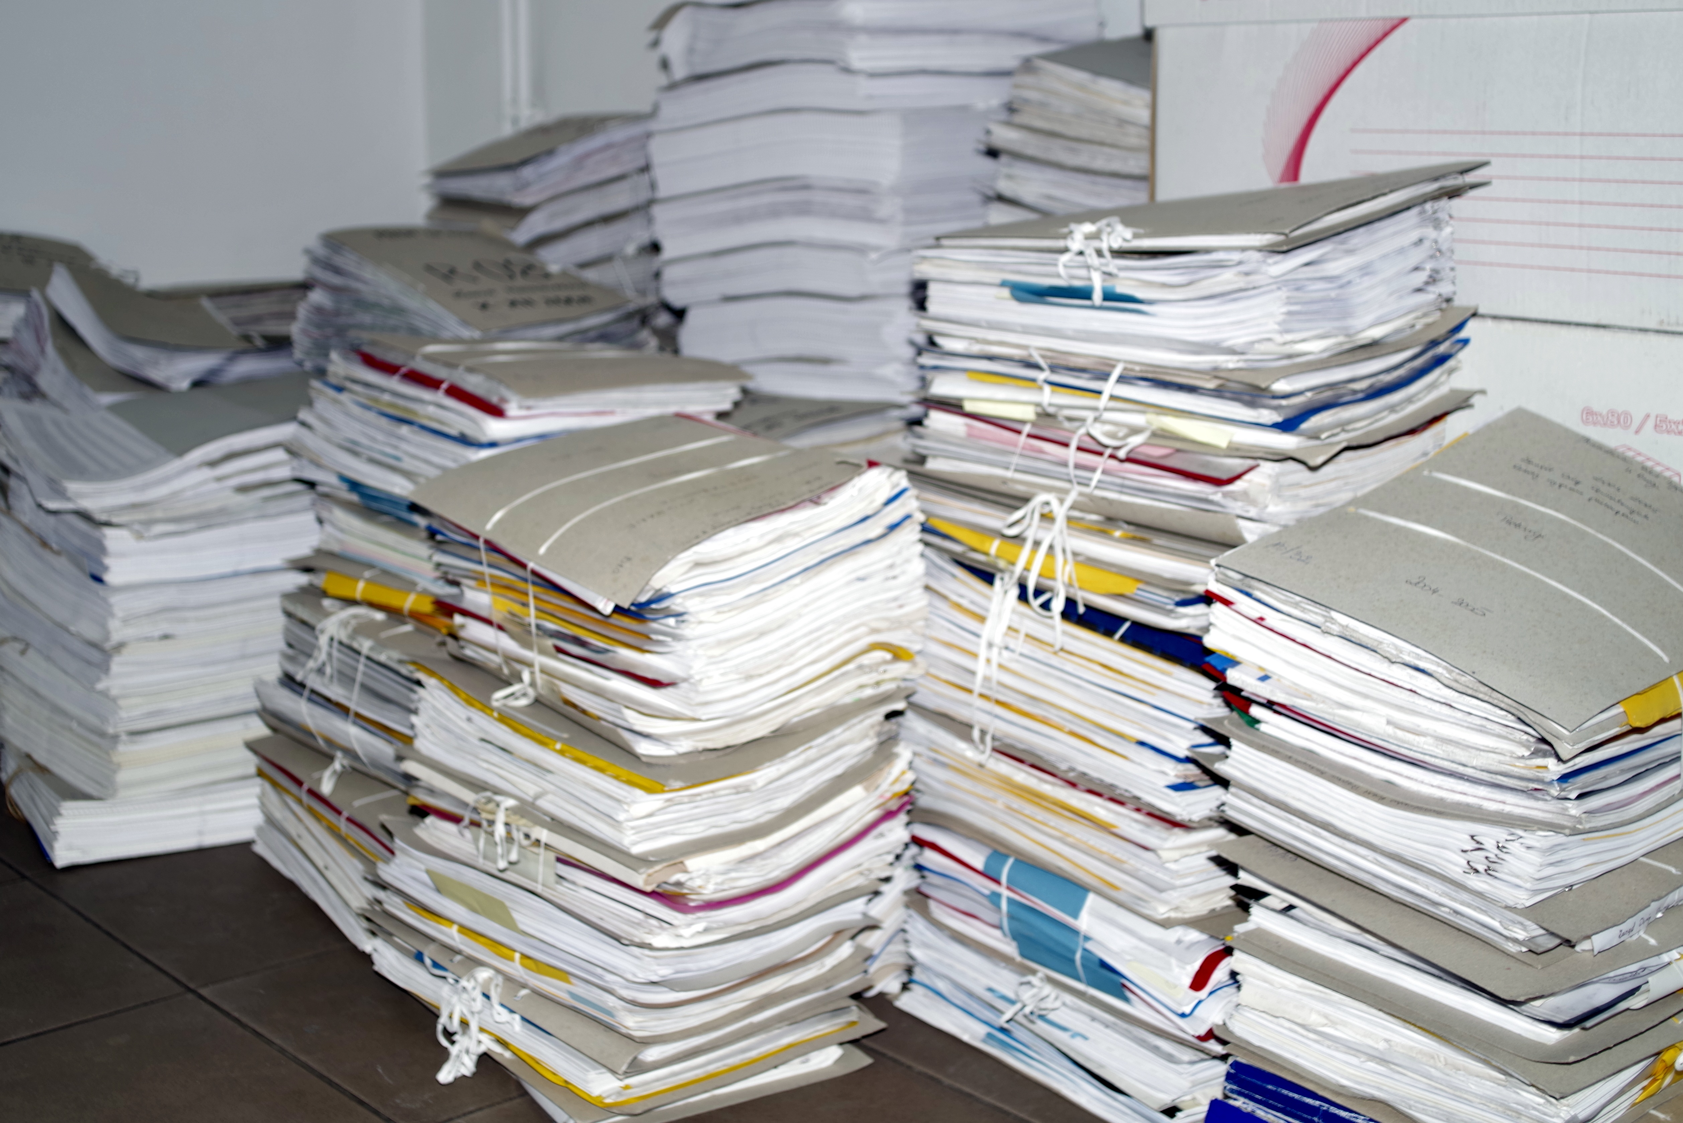
What Should You Backup?
Notes:
So let's talk a little more about what to back up.
We often think of backing up our computers, digital things, but it's important to remember that hard copies need to be considered. (Sa. scanned her lab notebook once a week and saved the files.)

Slide 6
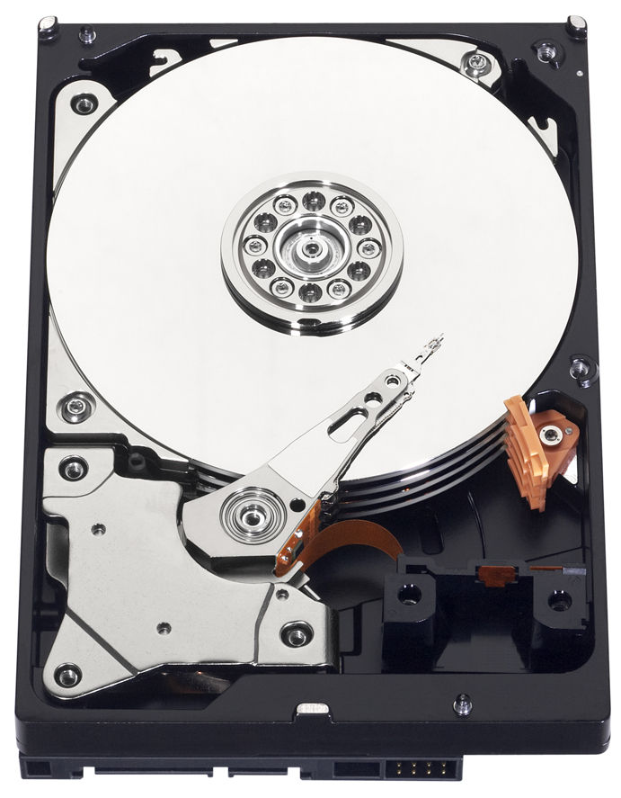
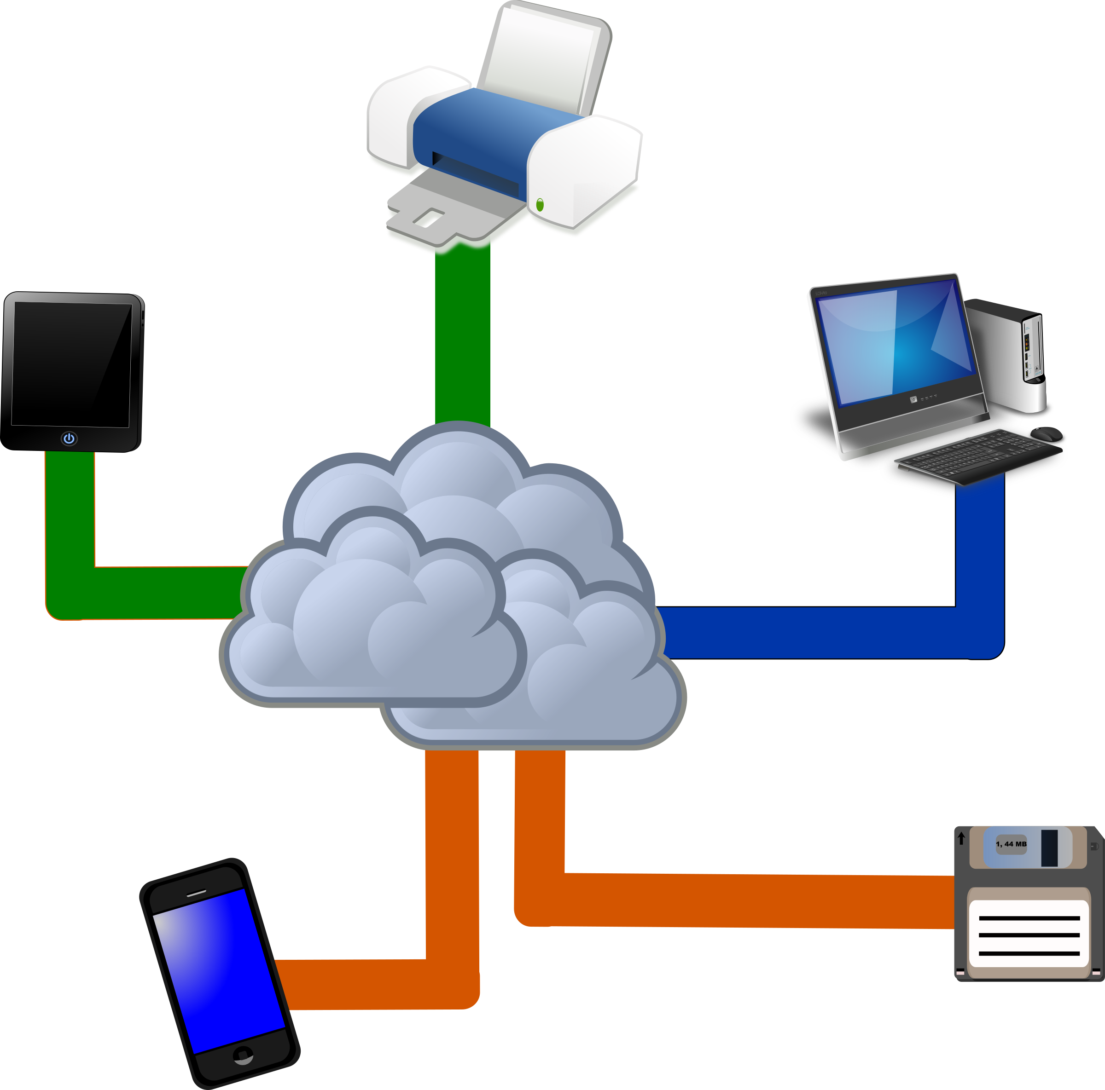
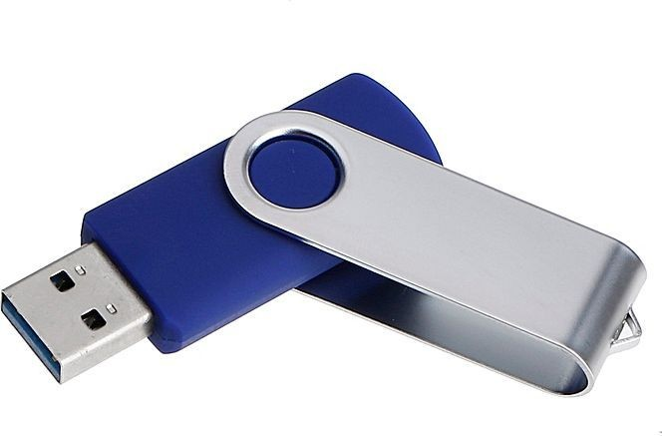
Where Should You Backup?
Notes:
Hard disks or external drives, the cloud, or even print copies...
But what about these? Flash drives? You can now get some with several GB for not much money but…
Not designed for storage – unreliable
Small – can be easily lost or damaged

Slide 7
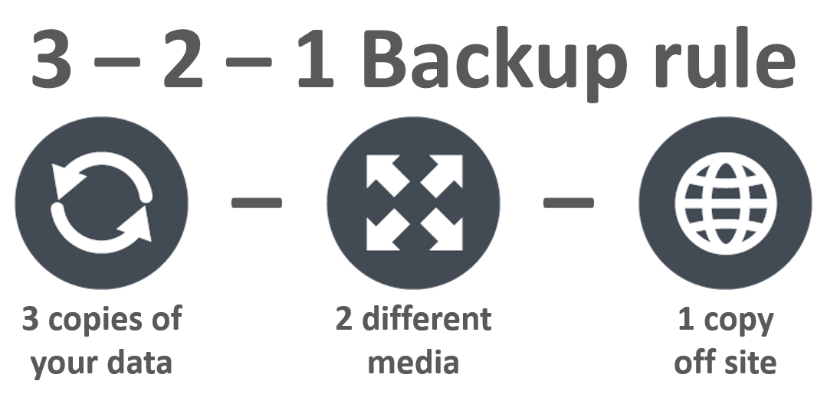
Where Should You Backup?
Notes:
Beware of syncing cloud services!

Slide 8
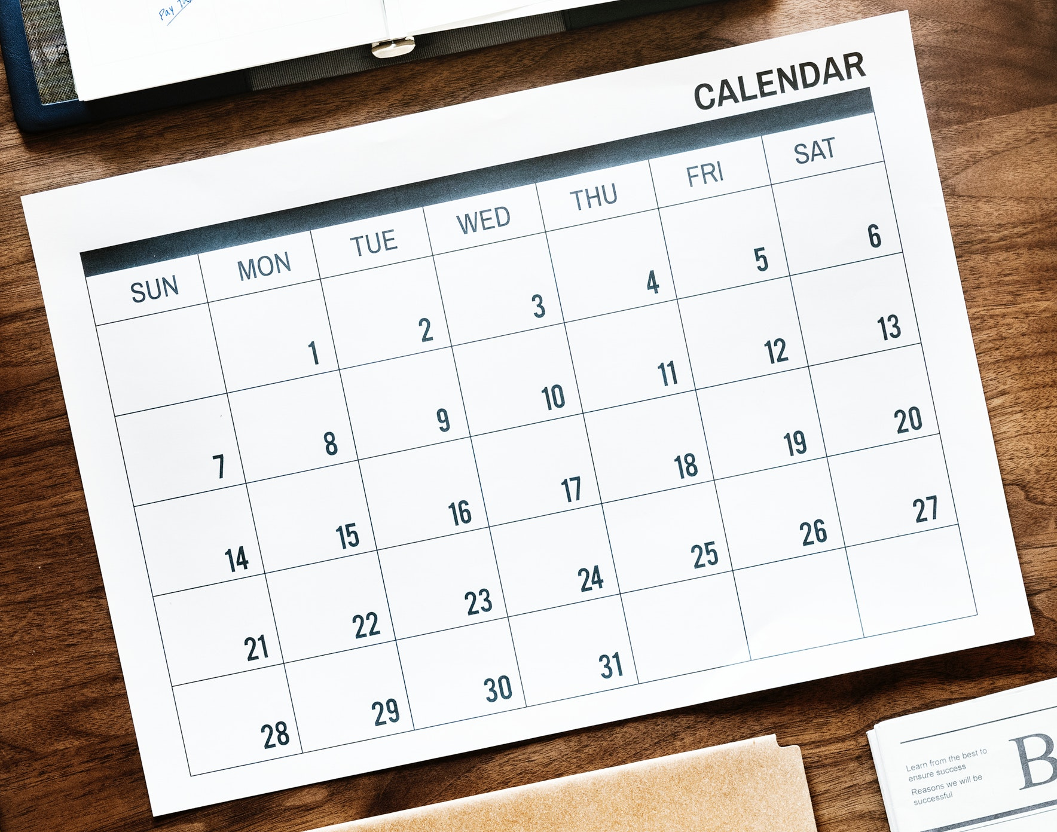
When Should You Backup?
It Depends…
How often does the data change?
How much work would be lost between backups?
What would it cost to replace the work?
How much work does it take to backup?

Slide 9
When Should You Backup?
Start a Backup Culture
Work as a team
Clearly define responsibilities
Have a regular Backup Day

Slide 10

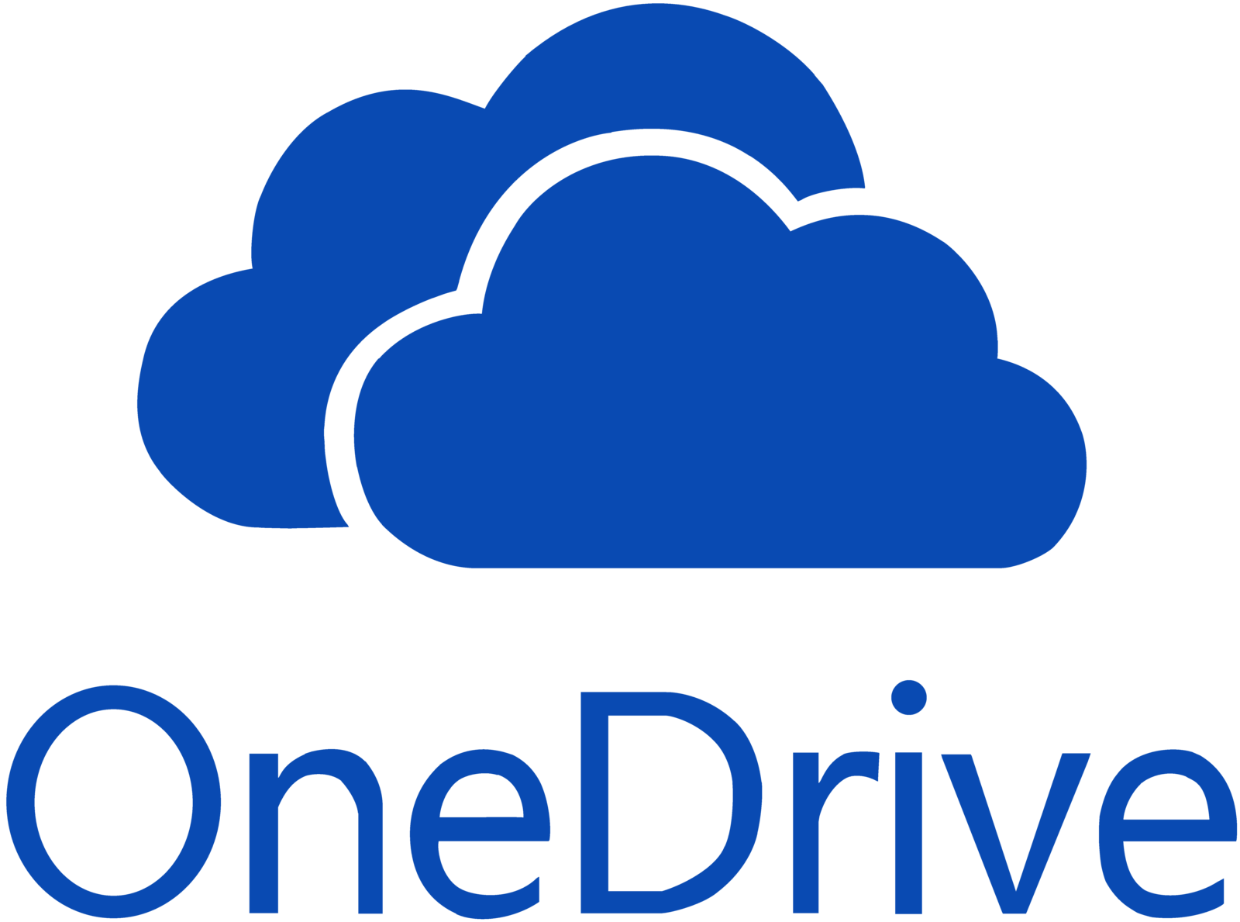


How Should You Backup?
Github
OSF
IRB, HIPPA sensitivity of data
TimeMachine Macs, Windows Backup, Rsync
Commercial Packages
Build cost into grants
Good DMPs (See DAVIS!)
And many others…

Slide 11
Case Studies
Who should backup?
What should be backed up?
Where should backups be done?
When should backups be done?
Why should backups be done?
How should backups be done?

Slide 12
Get help and learn more
Scheduled data workshops
https://libraries.ou.edu/events
Workshops on request
https://libraries.ou.edu/workshops-on-request
Information Specialists https://libraries.ou.edu/davis
https://libraries.ou.edu/dsl

Slide 13
Upcoming events!
More Love Data Week 2020
Feb 14, 11am-noon: Managing Research Projects with OSF
Feb. 20, 11am-2:30pm: Data in Plain Sight

Slide 14
Please take 3 min to help us improve
Survey link: https://ou.libwizard.com/f/datasurvey
Workshop topic: Survival Skills: Backups 101
Workshop date: February 17, 2020
This slide deck available on our archive at https://osf.io/aw9y3/
Notes:
A follow-up email will be sent with the link to this survey along with a link to this slide deck.

